Slide 1
Detection of Phishing Website using Machine Learning Model based URL Analysis
Week - 3 : Data collection – assembling a dataset of phishing and legitimate URLs.
Priyanka Patil

Slide 2
DATASET OVERVIEW: LOADING THE DATA
Dataset Obtained From: Kaggle
Link : https://www.kaggle.com
Size and Composition: The dataset comprises 11,054 samples.
Features: It includes 32 features per sample.
Feature Types: All features are integers, representing various aspects of website URLs.

Slide 3
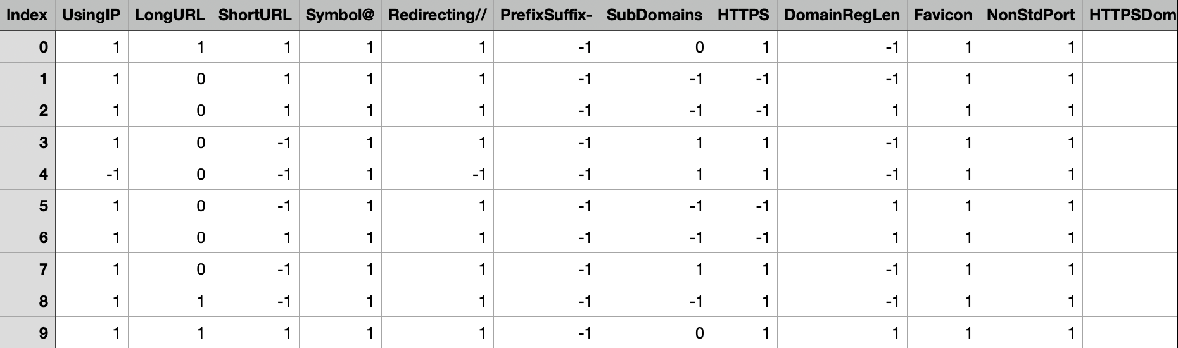
DOWNLOADED DATASET:

Slide 4
BRIEF DESCRIPTION ABOUT THE DATASET:
Primary Use: The dataset is designed for the purpose of distinguishing between phishing and legitimate websites.
Relevance to Phishing Detection: Each feature in the dataset represents characteristics of URLs that are commonly manipulated by phishers, such as the use of IP addresses, URL length, and the presence of special symbols etc.
Each feature is designed to capture specific characteristics of a website, which are then used in a machine learning model to classify the websites. The 'class' column serves as the label, indicating whether a website is phishing (1) or not (-1) and suspicious (0).

Slide 5
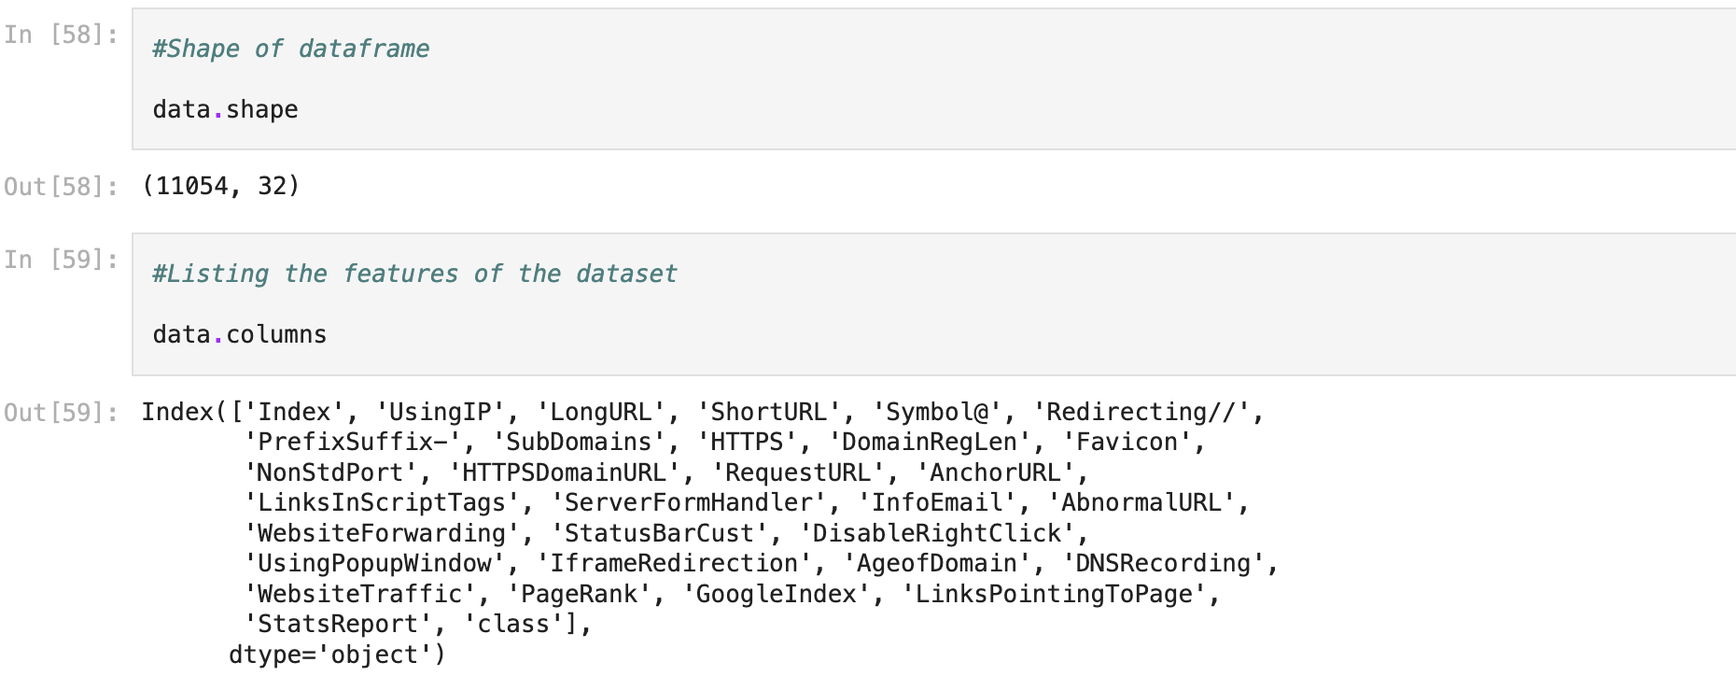
FAMILIARIZING WITH DATA AND EXPLORATORY DATA ANALYSIS (EDA)

Slide 6
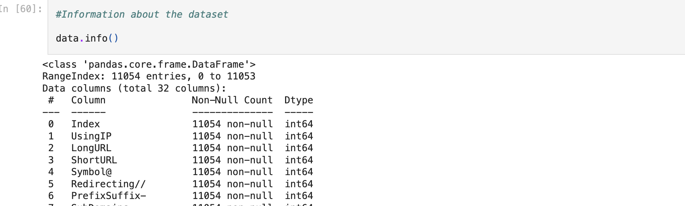
Description: This column serves as a unique identifier for each entry in the dataset, ensuring every record can be individually referenced. Data Type: Integer (int64) Characteristics: Contains no missing (non-null) values, indicating a complete dataset with a unique index for every entry. Utilizes a 64-bit integer format, suitable for datasets with large number of records.

Slide 7
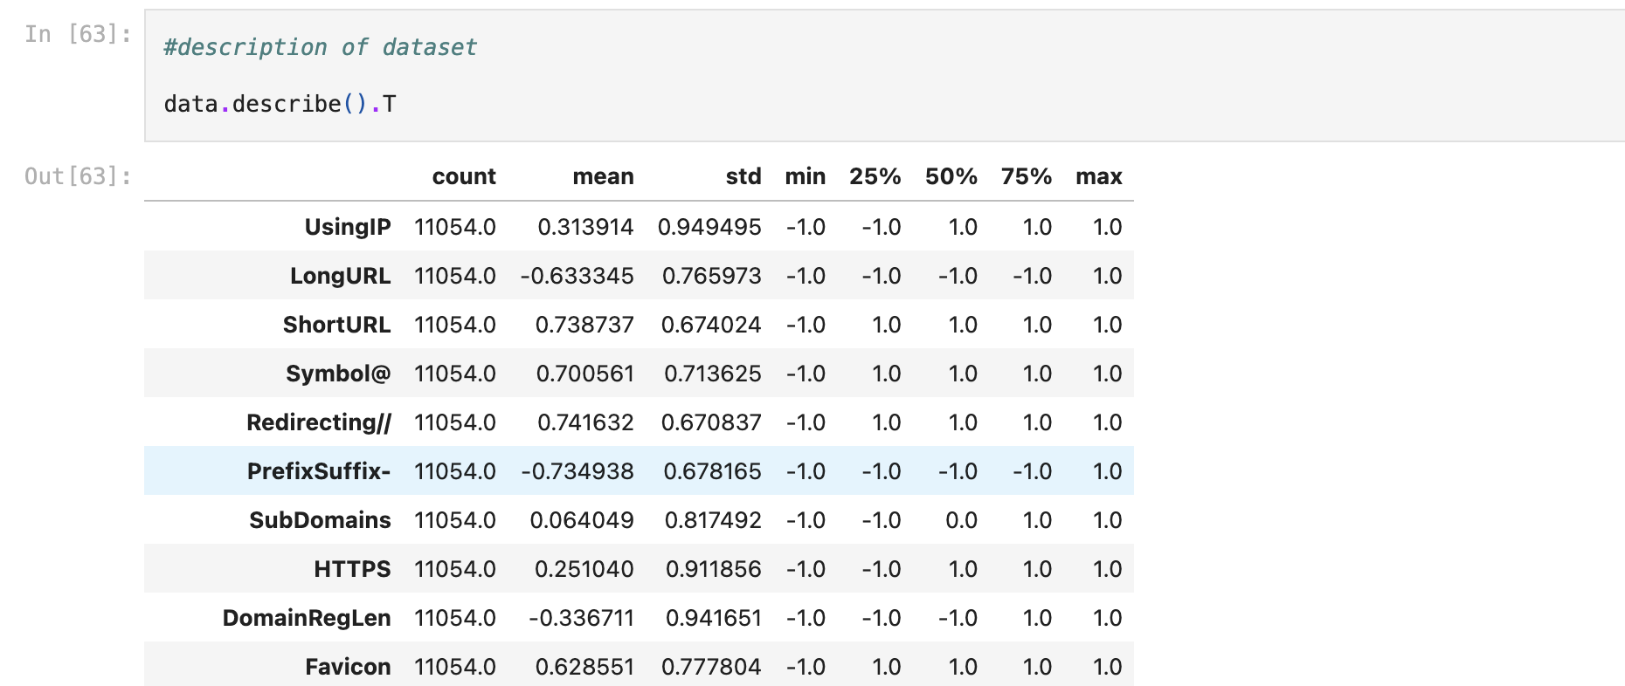

Slide 8
For Example – For "UsingIP”
count: The number of non-null entries. For 'UsingIP', there are 11,054 entries.
mean: The average value of the entries in the column. For 'UsingIP', the mean is approximately 0.313914. This is the sum of all values in the column divided by the count.
std (Standard Deviation): This measures the amount of variation or dispersion in the data. A low standard deviation means that the data points are close to the mean, while a high standard deviation means that the data points are spread out over a wider range. For 'UsingIP', the std is 0.949495.
min (Minimum): The smallest value in the column. For 'UsingIP', the minimum value is -1.0.
25% (25th Percentile): This is the value below which 25% of the data falls. For 'UsingIP', 25% of the entries have a value less than or equal to -1.0.
50% (Median or 50th Percentile): The middle value of the dataset. If you sort the data from the smallest to largest, the median is the value in the middle. For 'UsingIP', the median is 1.0.
75% (75th Percentile): The value below which 75% of the data falls. For 'UsingIP', 75% of the entries are below 1.0.
max (Maximum): The largest value in the column. For 'UsingIP', the maximum is 1.0.

Slide 9
The Final Observations From Dataset:
Observation 1: The dataset contains 11,054 instances and 31 features.
Conclusion: This is usually determined by examining the shape of the dataset, typically using a function like shape in pandas (e.g., data.shape()). The first number represents the rows (instances), and the second represents the columns (features). Typically, in data analysis, an "instance" typically refers to a single data entry (in this case, a website URL), and "features" are the individual characteristics measured for each instance.

Slide 10
Observation 2 : Out of 31 features, 30 are independent, and 1 is dependent.
Conclusion: In a typical classification dataset, one feature is the target variable (dependent), which the model aims to predict, and the rest are used as input variables (independent). So, in my dataset, the 'class' feature indicating phishing or legitimate status is the dependent variable.
Observation 3: Each feature is in integer datatype.
Conclusion: This can be ascertained using a method like data.info() in pandas, which lists each feature along with its data type.

Slide 11
Observation 4:No outlier is present in the dataset.
Conclusion: This might be inferred from observing the range of feature values and understanding the nature of the dataset. Since features are categorical and encoded as integers within a known range (-1, 0, 1), values outside this range would be considered outliers. The observation suggests all values fall within this expected range.
Observation 5: There are no missing values in the dataset.
Conclusion: Missing data can introduce bias and affect the model's performance. The absence of missing values indicates that the dataset is complete, and no imputation or removal of missing data is necessary.

Slide 12
Week 4 & 5 – Data Visualization and Initial Feature Extraction.
TO BE CONTINUED…

